Slide 1
NUMERICAL DIFFERENTIATION AND INTEGRATION
Materi Kuliah Fisika Komputasi
Numerical Methods for Engineers, sixth edition
Steven C. Chapra
Berger Chair in Computing and Engineering, Tufts University
Raymond P. Canale
Professor Emeritus of Civil Engineering, University of Michigan
Copyright © 2010 by The McGraw-Hill Companies, Inc.

Slide 2
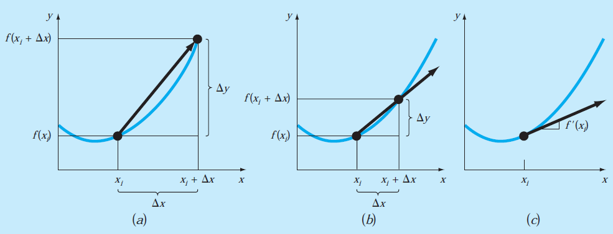
MOTIVATION
The graphical definition of a derivative: as Δx approaches zero in going from (a) to (c), the difference approximation becomes a derivative

Slide 3
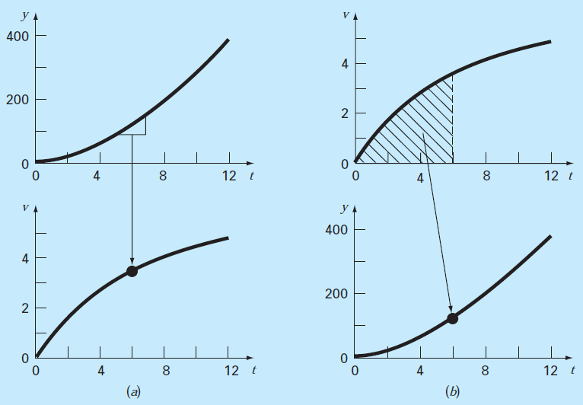
MOTIVATION
The contrast between (a) differentiation and (b) integration.

Slide 4
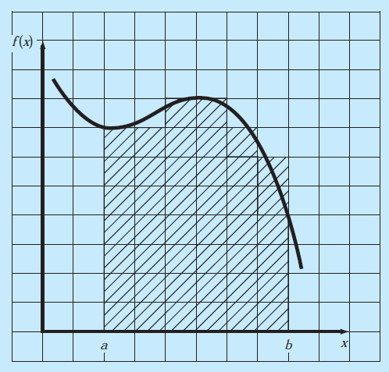
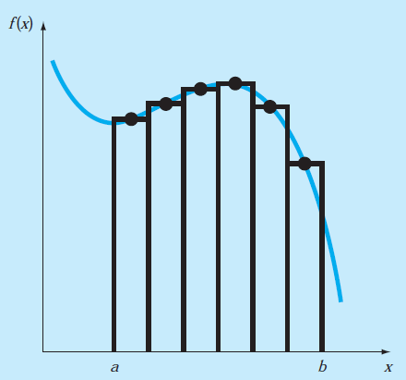
Noncomputer Methods for Differentiation and Integration
The use of a grid
to approximate an integral
The use of rectangles, or strips,
to approximate the integral

Slide 5
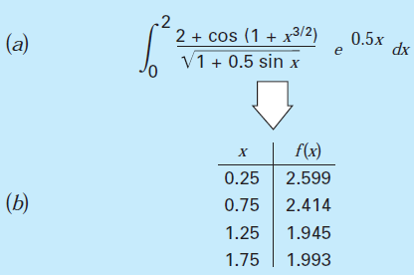
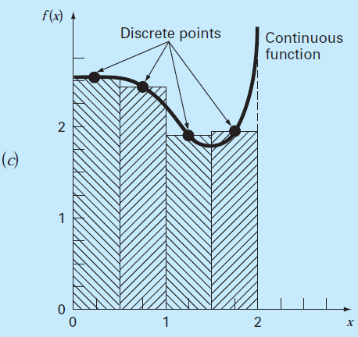
Noncomputer Methods for Differentiation and Integration
Application of a numerical integration method: (a) A complicated, continuous function. (b) Table of discrete values of f(x) generated from the function.
(c) Use of a numerical method (the strip method here) to estimate the integral on the basis of the discrete points.

Slide 6
Newton-Cotes Integration Formulas

Slide 7
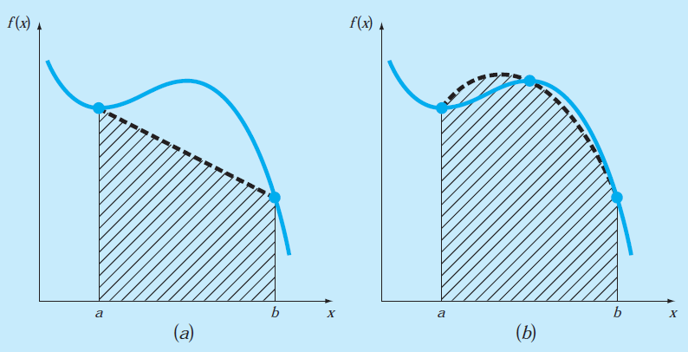
Newton-Cotes Integration Formulas
The approximation of an integral by the area under
(a) a single straight line and (b) a single parabola.

Slide 8
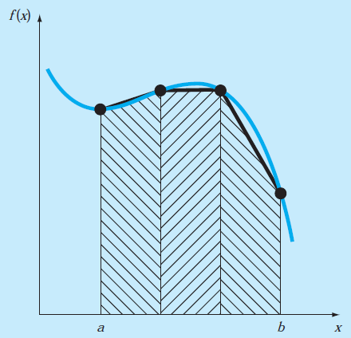
Newton-Cotes Integration Formulas
The approximation of an integral by the area under three straight-line segments.

Slide 9
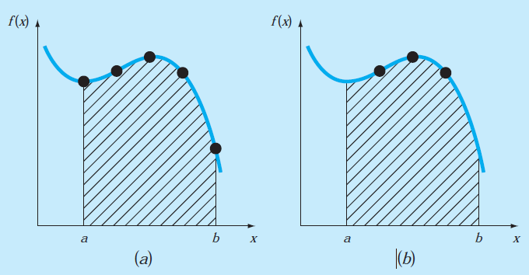
Newton-Cotes Integration Formulas
Closed and open forms of the Newton-Cotes formulas are available. The closed forms are those where the data points at the beginning and end of the limits of integration are known. The open forms have integration limits that extend beyond the range of the data .
The difference between (a) closed and
(b) open integration formulas

Slide 10
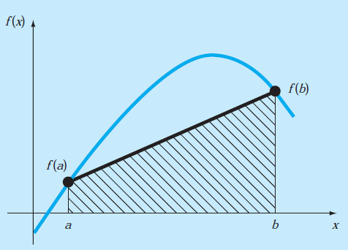
THE TRAPEZOIDAL RULE
The trapezoidal rule is the first of the Newton-Cotes closed integration formulas
The area under this straight line is an estimate of the integral of f (x) between the limits a and b:
The result of the integration (see Box 21.1 for details) is
Graphical depiction of the trapezoidal rule.
which is called the trapezoidal rule.

Slide 11
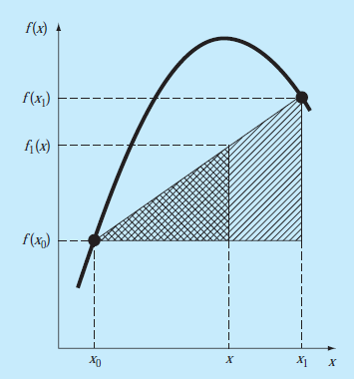
Linear Interpolation

Slide 13
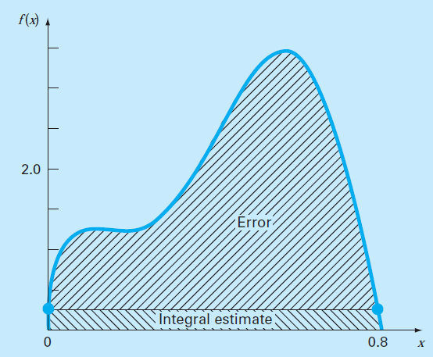
THE TRAPEZOIDAL RULE
Error of the Trapezoidal Rule
An estimate for the local truncation error of a single application of the trapezoidal rule is

Slide 14
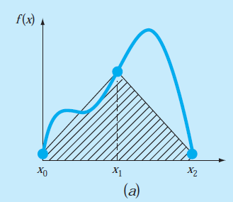
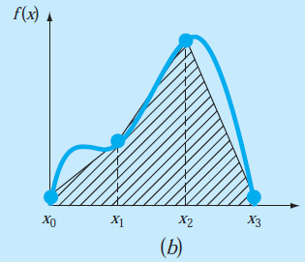
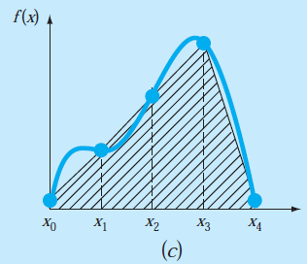
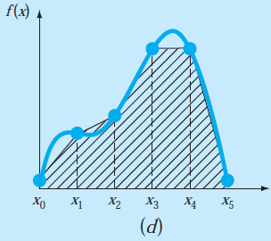
THE TRAPEZOIDAL RULE
The Multiple-Application Trapezoidal Rule
Illustration of the multiple-application trapezoidal rule.
(a) Two segments, (b) three segments, (c) four segments, and (d) five segments

Slide 15
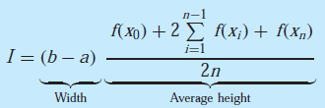
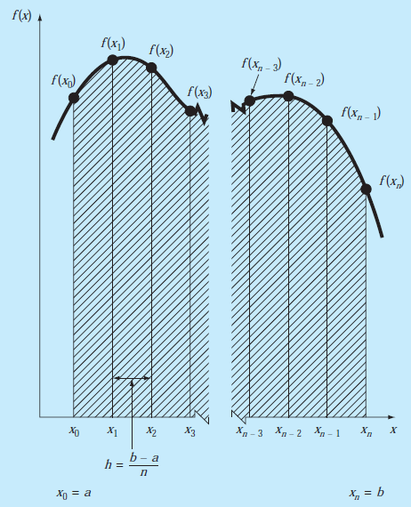
THE TRAPEZOIDAL RULE
The general format and nomenclature for multiple-application integrals

Slide 16
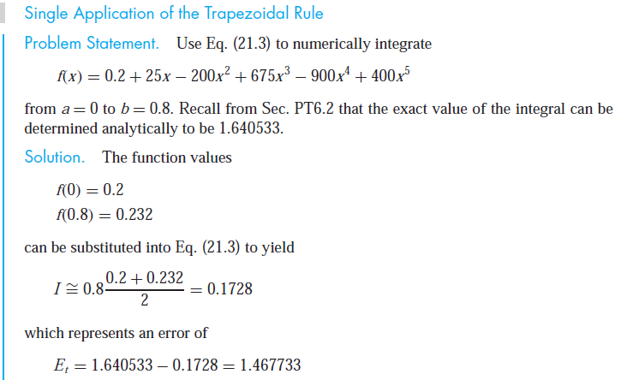
THE TRAPEZOIDAL RULE

Slide 17
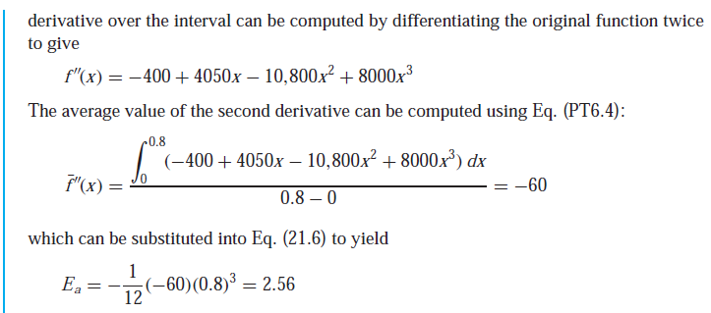
THE TRAPEZOIDAL RULE

Slide 18
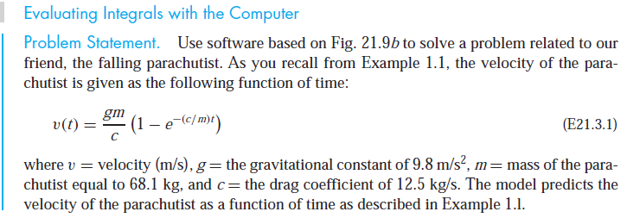
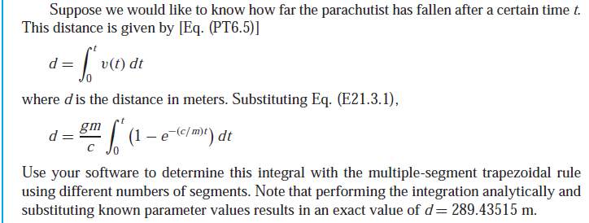
THE TRAPEZOIDAL RULE

Slide 19
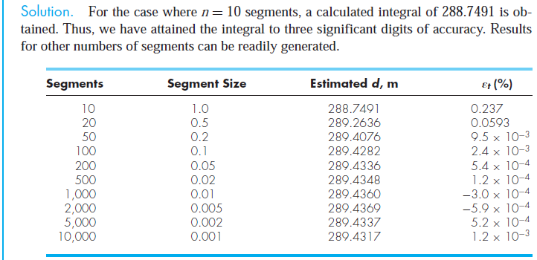
THE TRAPEZOIDAL RULE

Slide 20
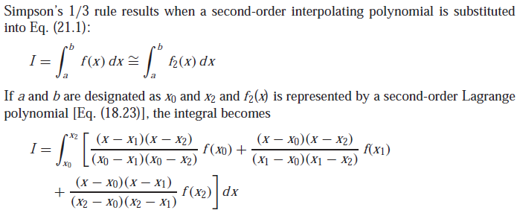
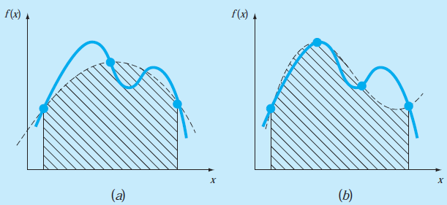
SIMPSON’S RULES
Simpson’s 1/3 Rule
(a) Graphical depiction of
Simpson’s 1/3 rule: It consists of taking the area under a parabola connecting three points. (b) Graphical depiction of Simpson’s 3/8 rule: It consists of taking the area under a cubic equation connecting four points.

Slide 21
SIMPSON’S RULES

Slide 22
SIMPSON’S RULES
THE TRAPEZOIDAL RULE

Slide 23
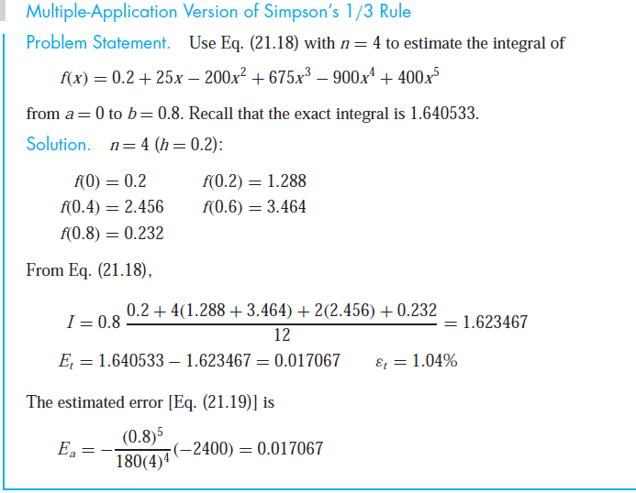
SIMPSON’S RULES

Slide 24
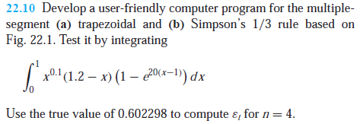

Slide 25
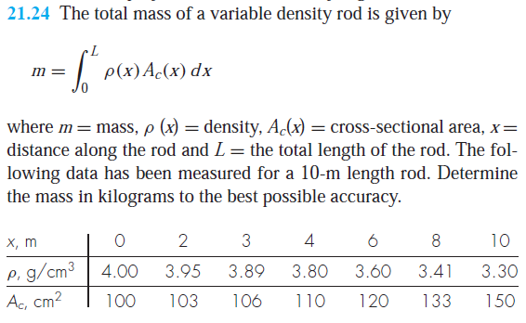

Slide 26
