Slide 1
PARTIAL DIFFERENTIAL EQUATIONS
Materi Kuliah Fisika Komputasi
Numerical Methods for Engineers, sixth edition
Steven C. Chapra
Berger Chair in Computing and Engineering, Tufts University
Raymond P. Canale
Professor Emeritus of Civil Engineering, University of Michigan
Copyright © 2010 by The McGraw-Hill Companies, Inc.

Slide 2
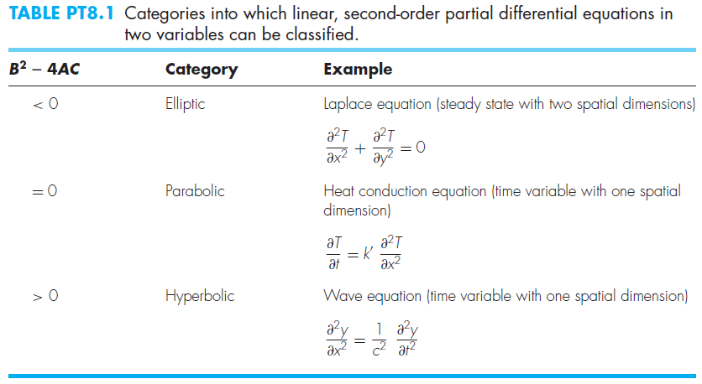

Slide 3
The Laplacian Difference Equation

Slide 4
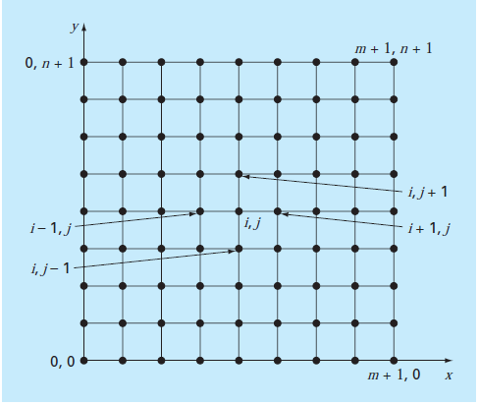
A grid used for the finite-difference solution of elliptic PDEs in two independent variables such as the Laplace equation.

Slide 5
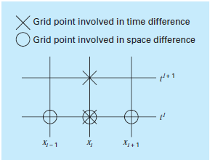
Finite Difference: Parabolic Equations
The heat-conduction equation.
A computational molecule for the explicit form.

Slide 6
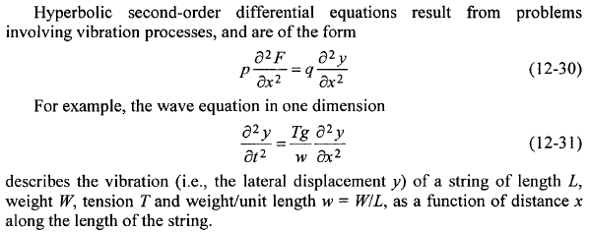
Hyperbolic Partial Differential Equations

Slide 7
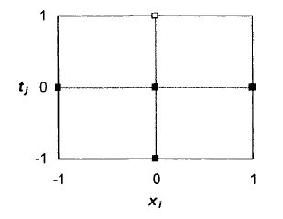

Slide 8
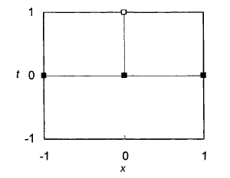
Solving Parabolic Partial Differential Equations: The Explicit Method
when i represents distance x and j represents time t,

